Slide 1
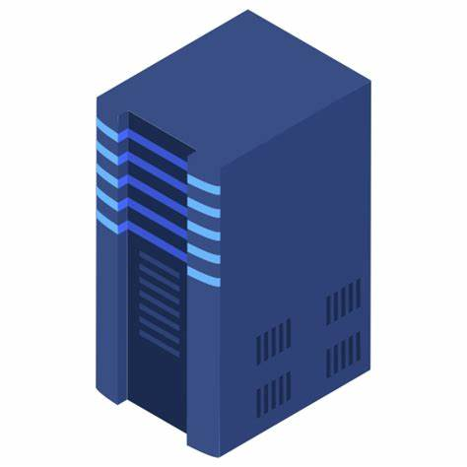

Import the server keys (public key and private - gpg)
Import the client (public key - gpg)
3) Import server (public key - gpg)
4) Import client (public key and private - gpg)
Listen port 9021
5) Open a connection into port 9021
6) Send a signed message to server
8) Decipher the message and print in the console
7) Check the signature and if it is ok, send a cyphered message using asymmetric cypher to the client

